Slide 1
Exercice CommandLineParser
Jean-Pierre Planas

Slide 2
Goal (technic) of the exercice
Work with C# reflection
Use Generic type and contrainst
Improve our abstraction

Slide 3
What is the difference between ?
typeof keyword
GetType() method

Slide 4
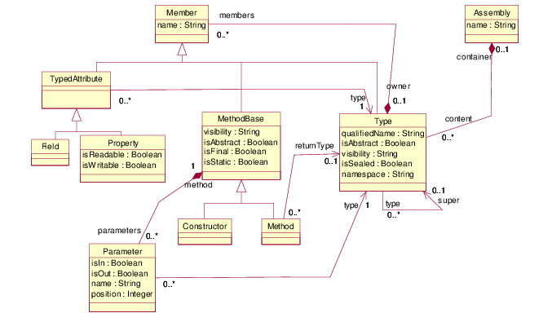
MetaModel

